Slide 1
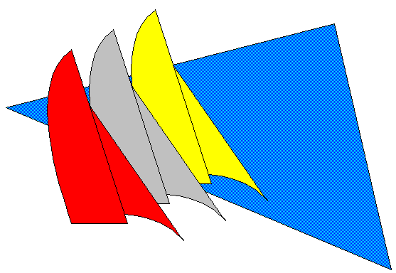
MORF BYC CCYC LEARN TO RACE Revision 1, Jan 2020
Notes:
1

Slide 2
Objectives
Why race at all?
Race organizing authorities in Corpus Christi
2020 CC Bay Race Schedule
PHRF handicaps; what they are and how to get one.
Local race protocol and typical race courses.
Race documents and registration.
Conventional and pursuit start sequences
General racing rules

Slide 3
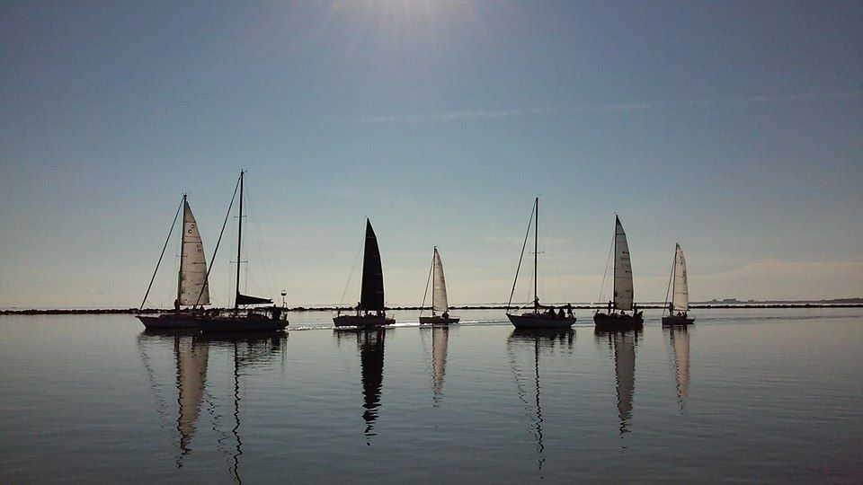
Why race your sailboat? Why participate in a Regatta?
You will learn a lot.
You are guaranteed to improve your sailing skills in all conditions.
You will make a lot of new friends.
Racing is competitive, challenging and a bucket load of fun.

Slide 4
CC Bay Organizing Authorities
US Sailing National authority for competitive sail racing.
Corpus Christi Yacht Club ccyc.com
Port A / Ladies Races, Navy Regatta / Military Challenge, Frostbite, National / International regattas.
Midget Ocean Racing Fleet (MORF) ccmorf.org
Wednesday night races and others.
Bay Yacht Club bayyachtclub.org
Pursuit Series, Turkey Day Regatta

Slide 6
Handicaps
Question: How does a mixed fleet of sailboats with vastly different configurations, sail plans and speed potential compete more-or-less equally against one another?
Answer: The same way as do golfers of disparate abilities … sailboats are handicapped.

Slide 7
PHRF
Performance Handicap Racing Fleet
Handicapping system to make racing among different boats more equal.
Uses performance results from around the country
Handicap expressed as seconds per mile

Slide 8
PHRF: Time on Distance Scoring
Boat A
PHRF of 50 sec/mi
Ten mile course
Boat B
PHRF of 110 sec/mi
Ten mile course
Boat A will “owe” 60 seconds per mile to Boat B (110 - 50)
On a 10 mile race, Boat A must finish more than 600 seconds (10 minutes) ahead of B in order to beat B on corrected time.

Slide 9
PHRF: How to Get a Rating
Join MORF. Membership $40 annually.
Submit the PHRF application found on the MORF website to the South Texas PHRF Committee.
SOTX PHRF Committee meets quarterly. Will issue provisional rating and review after one year. Issue certificate.
Race organizers can assign temporary rating.

Slide 10
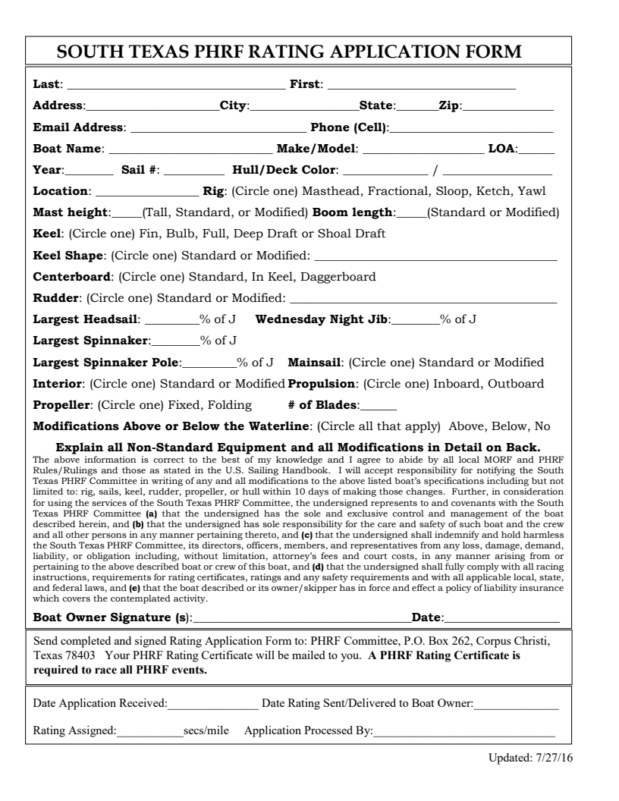

Slide 11
Review
Local Organizing Authorities
2020 Schedule
PHRF Handicap
Questions???

Slide 12
Local Classes for Mixed Fleet Races
All Sails Class – Boats use all their available and legal sail inventory including spinnakers.
Non-Spinnaker (a.k.a. 150) Class - Boats use all their available and legal sail inventory, but may not fly a spinnaker, gennaker, code zero, etc. Largest headsail (jib) cannot have LP greater than 150% of J. May pole out jib with spinnaker or whisker pole on downwind legs.
Working Sail Class – Same as Non-Spin with the added limitation of no headsail greater than 105% of J.
Multi-Hull Class – As implied

Slide 13
Race Course Layout
Windward-Leeward Courses
- One Design, All Sails, CCYC Race Week, Deniz Tor, Barry Brown Frostbite as examples
Random Leg Courses
- Non-Spin, Port Aransas, Navy Regatta, Wed nights as examples.

Slide 14
Windward - Leeward
Windward – Leeward
.
Wind Direction
Start
(Windward – Leeward twice around)
Finish

Slide 15
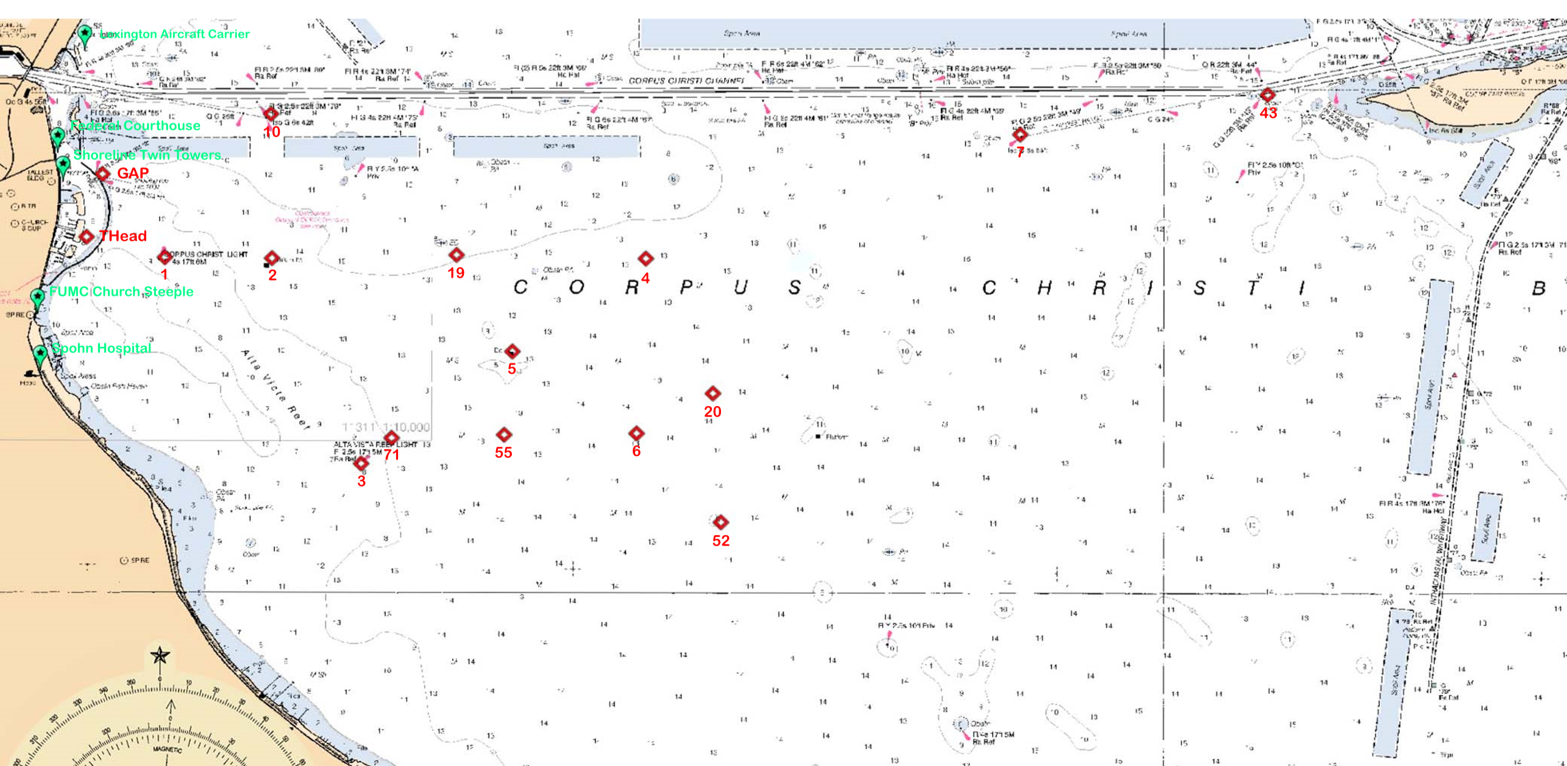
Random Leg
Corpus Christi Bay Race Marks (chart)
Download PDF from MORF or BYC Website.

Slide 16
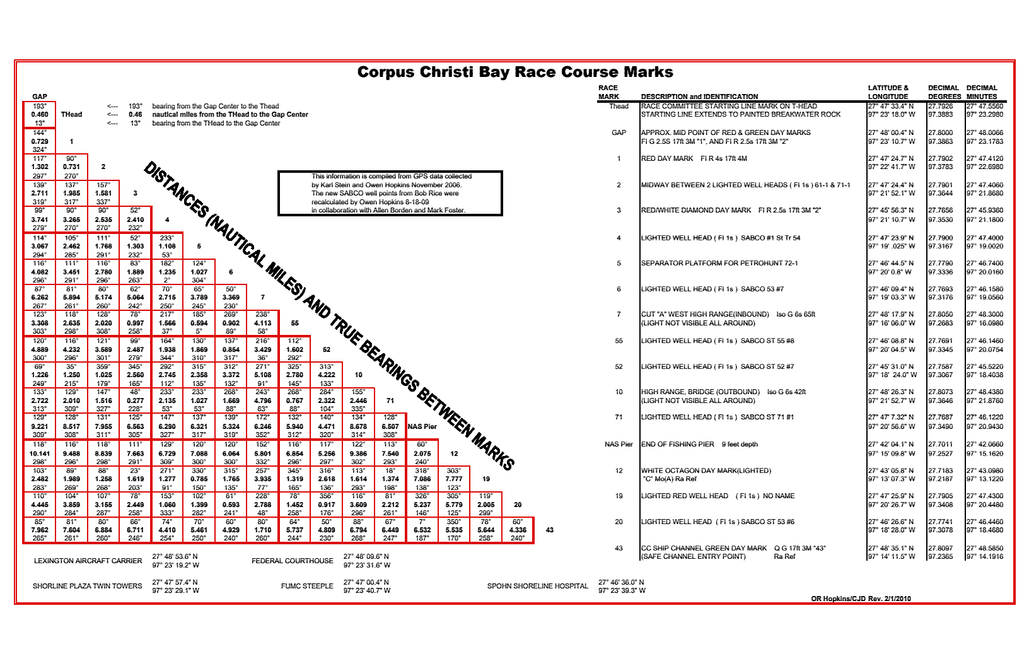
Load these coordinates in your chart plotter or handheld GPS.

Slide 17
Review & Questions
Local Classes
Race Courses
CC Bay Race Marks

Slide 18
Race Notification and Registration
Email from Organizing Authority sent to MORF and yacht club race chairs.
MORF and clubs broadcast to members.
Announces the race w/ hyperlink to Regatta Network.
Register and pay entry fee on Regatta Network.

Slide 19
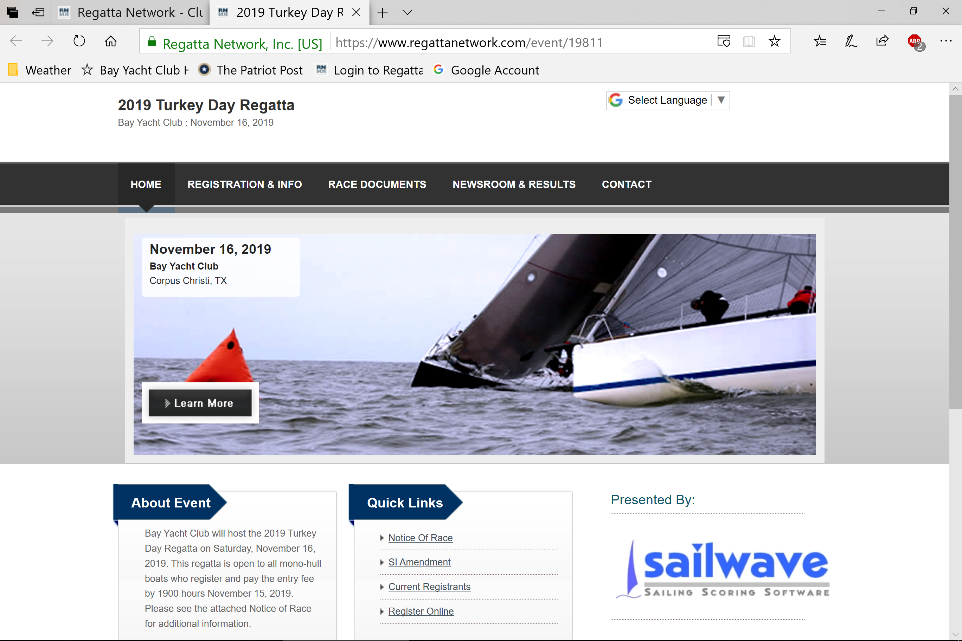
Race Registration
REGATTA NETWORK RACE REGISTRATION

Slide 20
Race Documents
Download from Regatta Network
Notice of Race (NOR) contains:
Date / time of race and event schedule
Classes eligible to race
Registration fees, cut-off dates
Scoring system if different from standard low-point
Prizes
Other race related information.
Sailing Instructions (SI) contains:
Schedule of races, classes and class flags, times of warning signal for each class
Courses to be sailed / list of marks to be used
Location of starting area, Description of starting / finishing marks and starting / finishing lines
Approximate course length / length of windward legs
Prizes
Other race specific information
HINT – Bring your copy of SI to pre-race skippers meeting!!!

Slide 21
Review & Questions
Notification of a pending race
Regatta Network
Registering for a race
Key race documents
NOR
SI
QUESTIONS????????

Slide 22
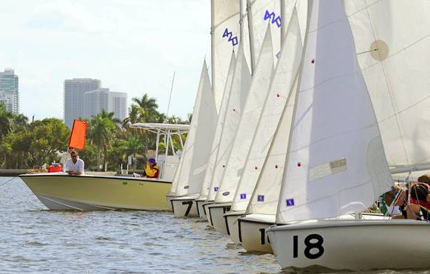
Starting Sequence
Starting sequence
Flags
Horns
Timing
Other flags

Slide 23
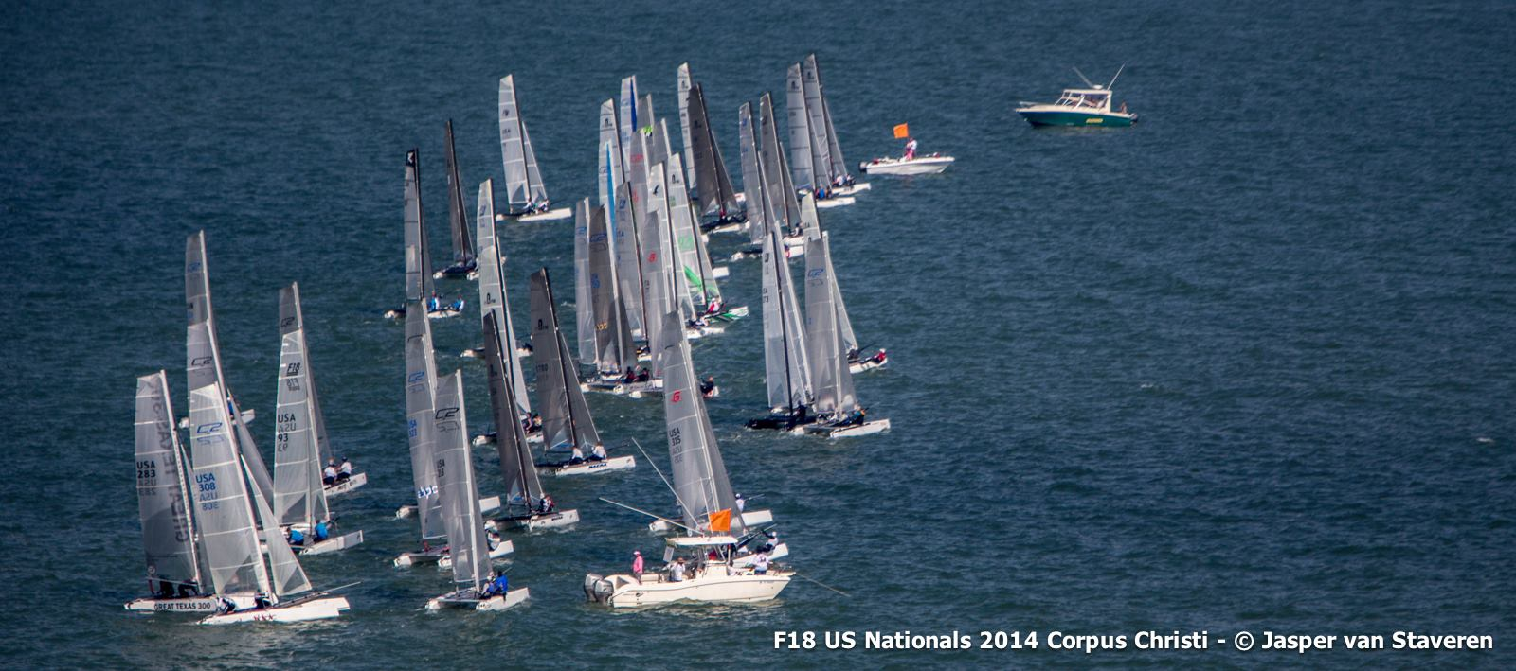
Start/Finish w/ RC Signal Boat
Positions the RC signal boat and sets up the course
Course designations (chalkboard)
Starting sequence signals (horns and flags)
Other commonly-used flags

Slide 24
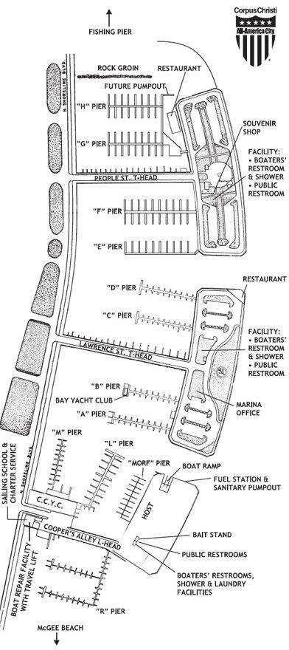
Wednesday Night and Races Using the “Wed. Night” Line
White stick
Start/finish

Slide 25
Course Designations (on whiteboard)
Gap – 71p – 19p – Gap
- Finish
090
Chalkboard at stern of committee boat or on gearbox if using Wednesday Night line.
Course and/or Bearing Information
Write the course down or take a photo w/ smart phone.
Check in on Starboard tack! Or as per Sailing Instructions

Slide 26
Warning Signal
The warning signal is a class flag displayed 5 minutes before the start. Classes and class flags are identified in the SI.
wind
Horn!
RC
Class Flag – know your color!!
Notes:
26
26

Slide 27

Preparatory Signal
“Prep” is a blue & white flag raised 4 minutes before the start. Class flag remains up. You are racing when your prep flag is raised.
wind
Horn!
RC
Notes:
27
27

Slide 28
One Minute
Three minutes later, at one minute before the start, “Prep” is lowered. The class flag remains up.
wind
Horn!
RC
Notes:
28
28

Slide 29
Start
Class flag is lowered, with a horn, at the class start.
wind
Horn!
RC
On a rolling start the next class flag will go up!!
Notes:
29
29

Slide 30
Starting Sequence Summary
Starting Sequence
Time
Flags
Sound
Warning
5
CF
1 Sound
Preparatory
4
CF
1 Sound
One Minute
1
CF
1 Sound Long
Start
0
CF
1 Sound

Slide 31
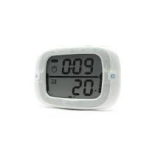
Electronic Aids
Watch
Special Devices
Count down from 5 or 4 minutes.
Appoint one crew to be timekeeper! Give that person an opportunity to get the time hack.

Slide 32



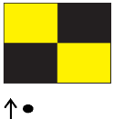
Other Flags
Flag Horn
Flag Horn
Individual Recall
Race is Abandoned
General Recall
Come Within Hail of RC boat
Postponed

Slide 33

Individual Recall
The RC will raise the X flag if a boat is over the line at the start.
You’re over!
wind
RC
Listen to radio or if unsure go back behind the start line and restart
flag will go down when clear
Notes:
33
33

Slide 34
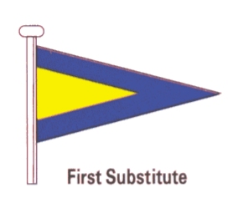
General Recall
The RC may signal a general recall if many boats are over the line at the start.
wind
Horn!
Horn!
RC
Listen to radio/horns
5 minute sequence will start again
Notes:
34
34

Slide 35
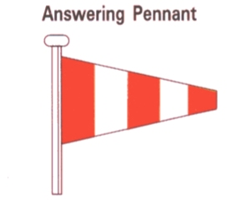
Postpone
The RC may postpone the race for lack of wind, changing wind direction, etc. Another signal 1 minute after AP lowered.
Horn!
Horn!
No wind!
RC
Notes:
35
35

Slide 36
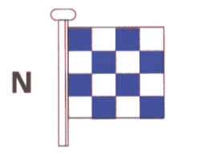
Abandon the Race
The RC may abandon the race for lack of wind, storms, etc.
Horn!
Horn!
Horn!
No wind!
RC
Notes:
36
36

Slide 37

Come within Hail
Code flag Lima means “Come Within Hail” of the RC boat for information or “Follow Me.”
Horn!
RC
Notes:
37
37

Slide 38
Pursuit Starts
The handicap is built into the start with the goal being all boats will hit the finish line at the same time!
Makes for a “true” finish!
Start time on the MORF site for Wednesday nights or issued by RC at skippers meeting.
Notes:
38
38

Slide 39
Pursuit Starts
Noon Start 2 Mile course
RC
A
12:00:00
Boat A PHRF 120
Boat B PHRF 90
Boat C PHRF 60
Boat D PHRF 30
B
12:01:00
C
12:02:00
D
12:03:00
Notes:
39
39

Slide 40
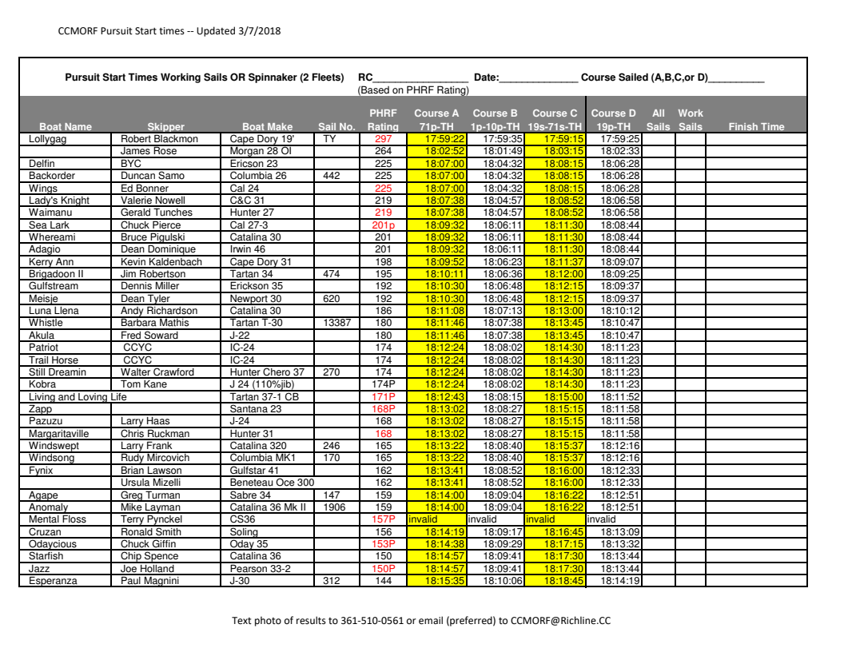

Slide 41
Review and Questions
Committee Boat start / finish
“Wednesday Night” start / finish area
Course descriptions on white board
Conventional Starts
Flag Sequence
Importance of timing
Recalls
Other Signals
Pursuit Starts

Slide 42
Starting line strategy
Find the favored end
Timing

Slide 43
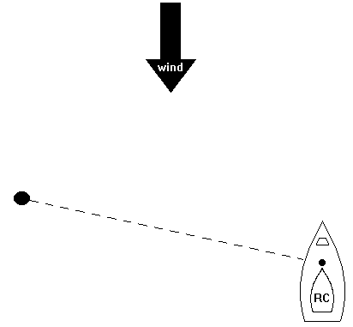

Favorite End of the Line

Slide 44
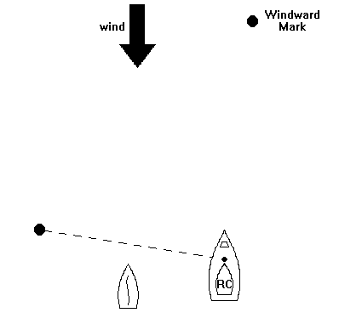
Determining Favorite End
Go to the middle of the line and go head to wind.
Then look to either side, left at the pin, and right at the committee boat.
Whichever is further ahead is the preferred end
Notes:
44

Slide 45
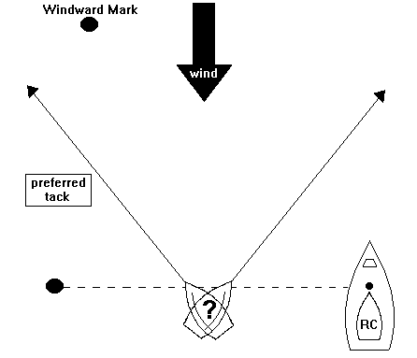
Which Tack
Take the tack that will take your boat straightest to the mark

Slide 46
Starting Summary
Large gains and losses are made at the start.
When your boat comes off the line, you want to be
in clear air
have good speed
be on the preferred side of the line
be on the right tack.

Slide 47
Upwind Strategy
stay “in phase” with the wind (tack when headed)
find the favored side of the course

Slide 48
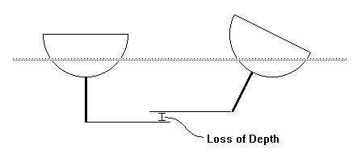
Keep the Boat Flat!!!
Maximizing the depth of the board in the water allows it to do its job the best. If you're slipping sideways while going upwind, you're losing ground to those who aren't.

Slide 49
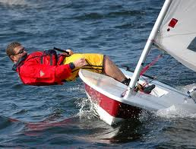
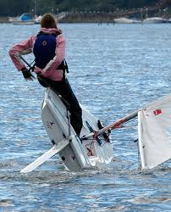
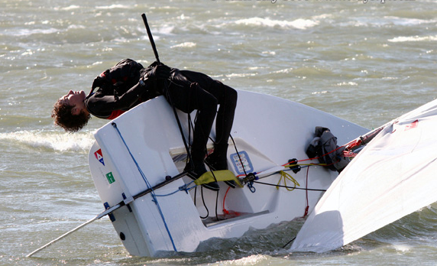
Hike Out

Slide 50
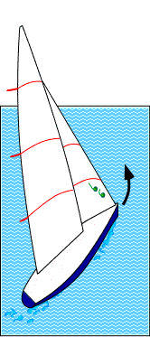
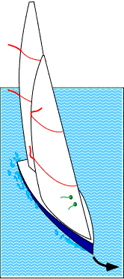
Upwind Steering - Watch the Telltales
Telltales are made of a light material which does not stick to the sail, such as yarn or audiocassette tape
Steer the boat, using the telltales as guides
Pointing too high
Pointing too low

Slide 51
Mainsail Leech Telltales
The telltale is attached at the end of batten pockets
The leech tails are of the most value in light to medium air when reaching.
In less than 5 knots of wind adjust the sheet so that the upper tail is visible only sometimes
In medium air the upper tail should show itself about 50% of the time
in heavy air all leech tails must fly constantly

Slide 52
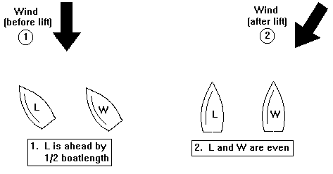
LIFTS
A lift will immediately give an inside boat an advantage.

Slide 53
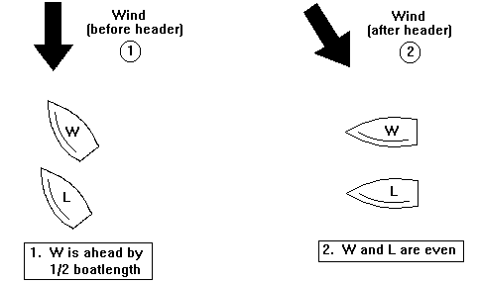
HEADERS
A header will give the outside boat the advantage

Slide 54
Covering when in the lead
Mark
NO
Yes
One very simple rule to follow is to stay between your opponent and the next mark.
A
B

Slide 55
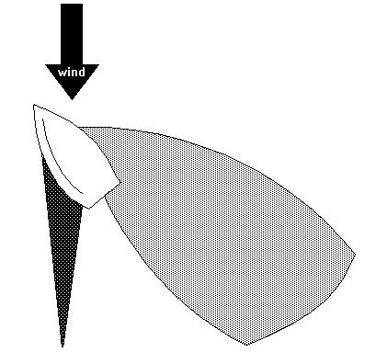
Blanketing & Back winding
Backwind Zone
Blanketing Zone

Slide 56
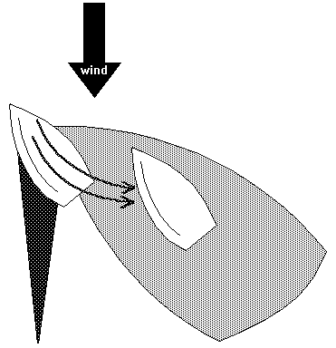
Back winding
This area extends much further than the blanket zone.

Slide 57

Laylines
Wind
Port Layline
Starboard Layline

Slide 58
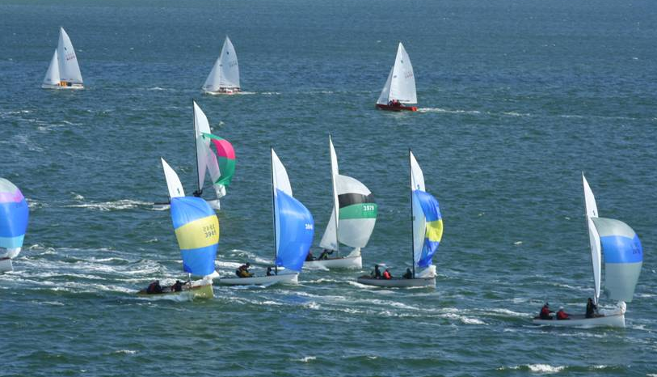
Downwind strategy
stay on the favored jibe
stay in clear air

Slide 59
Mark rounding strategy
Get to the inside
Approach on starboard tack whenever possible
Prepare for the next leg

Slide 60
Sail Trim
watch other boats!
don’t over-trim in light air

Slide 61
Rules
Universal rules: Racing Rules of Sailing – free with US Sailing membership
Is uncertainty about the rules keeping you from racing? Don’t let it! Knowing just a few basic rules will take care of almost all of the situations on the race course.
Download Basic Racing Rules from BYC Web.
Bayyachtclub.org > club info > programs > racing

Slide 62
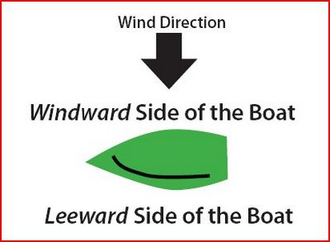
Review: Windward - Leeward

Slide 63
Review: Starboard - Port Tack
Wind Direction
Starboard Tack
Port Tack
Wind coming over the starboard (right) side of boat. Sails on port (left) side.
Wind coming over the port (left) side of boat. Sails on starboard (right) side.

Slide 64
Basic right-of-way rules
Basic rules everyone should know
Starboard tack/port tack
Windward/leeward
Overtaking
Rounding jibe or leeward marks
Don't hit other boats, even if you have the right-of-way!

Slide 65
Basic Rules 1
On opposite tacks, a boat on starboard tack boat has right of way over a port tack boat.
wind
Starboard!
Notes:
65
65

Slide 66
Basic Rules 2
On the same tack, a boat to leeward has right of way over a windward boat.
wind
Notes:
66
66

Slide 67
Basic Rules 3
When rounding a leeward mark, an inside boat must always be given room if the boats were overlapped 3 boat lengths from the mark.
wind
Room!
mark
Notes:
67
67

Slide 68
Basic Rules 4
A boat which is tacking or jibing must keep clear of one that is not
A boat clear astern must keep clear of boat ahead on the same tack
When a right-of-way boat changes course, she must give other boats room to keep clear
Notes:
68
68

Slide 69
Basic Rules 5
What do I do if I break a rule?
If you break a right-of-way rule, you must do two turns promptly after the incident
If you touch a mark, you must do one turn promptly
If there was serious damage, you must retire
You must keep clear of other boats when doing your penalty turns
Notes:
69
69

Slide 70
Running Situations
Tack is defined by which side the boom is on
wind
leeward
windward
port
starboard
Notes:
70
70

Slide 71
Windward Mark Rounding
At a windward mark, a boat on starboard tack has right of way over a port tack boat, even if overlapped.
wind
mark
Starboard!
Notes:
71
71

Slide 72
Barging – not allowed
An inside boat is not entitled to room at a start mark
wind
RC
Barging!
Notes:
72
72

Slide 73
General Summary of Rules
Port keeps clear of starboard.
Windward keeps clear of leeward
The boat astern keeps clear of the boat ahead.
A boat tacking keeps clear of one that is not.
Avoid collisions.
If you gain right of way or change course, give the other boat time to keep clear.
The inside boat(s) at three boat lengths from the mark is entitled to room to round the mark, if overlapped.
If you have violated one, take a penalty

Slide 74
For Kids and Small Boat Tacticians
1. Don't hit other boats. Collisions are slow and arguments are slower.
2. Port tack boat usually has to stay out of the way of everyone else.
3. Windward boats must stay away from leeward boats.
4. The inside boat gets to go around the mark first.
5. Don't hit marks. Doing circles is slow.
6. Don't hit the committee boat. First, it is a mark and second, it really makes them mad.

Slide 75
How to improve?
Practice your boat handling and crew work
Read books and newsletters
Ask questions!
Ask for experienced crewmember!

Slide 76
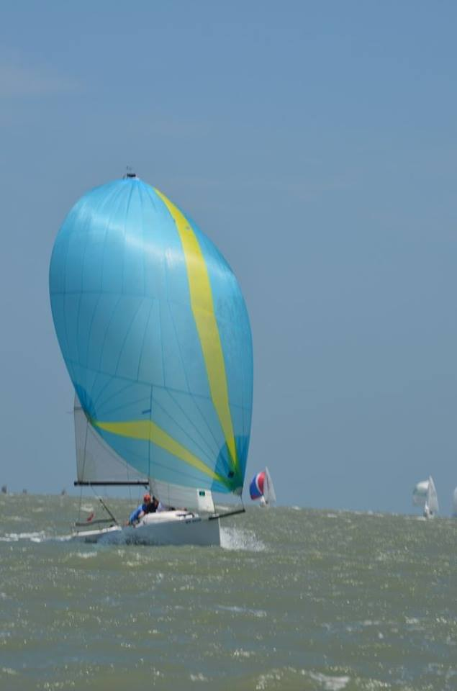
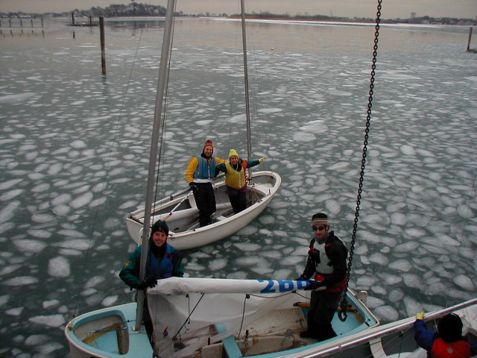
Questions! Jim Robertson Racing@bayyachtclub.org 361-929-1785

